Slide 1
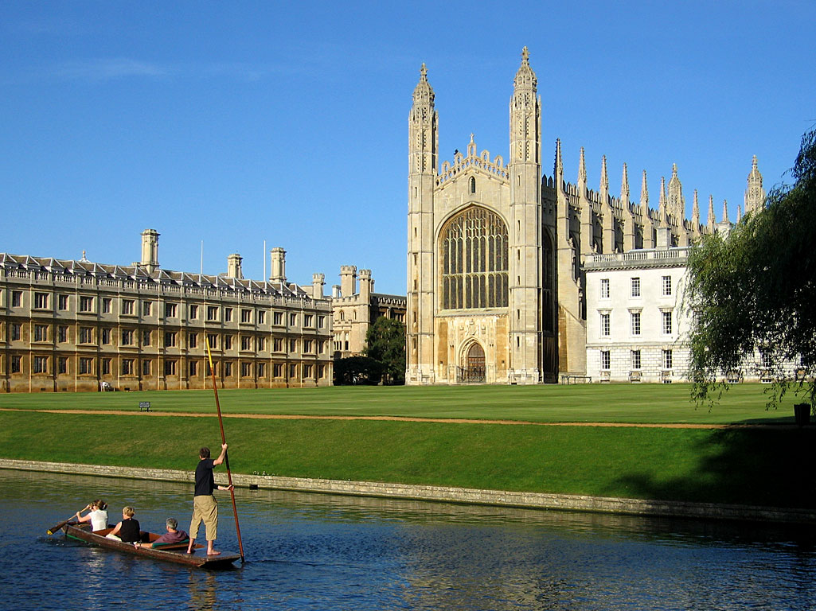



The 55th BSRG AGM
Cambridge
The one where BSRG goes proper fancy…

Slide 2
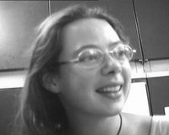
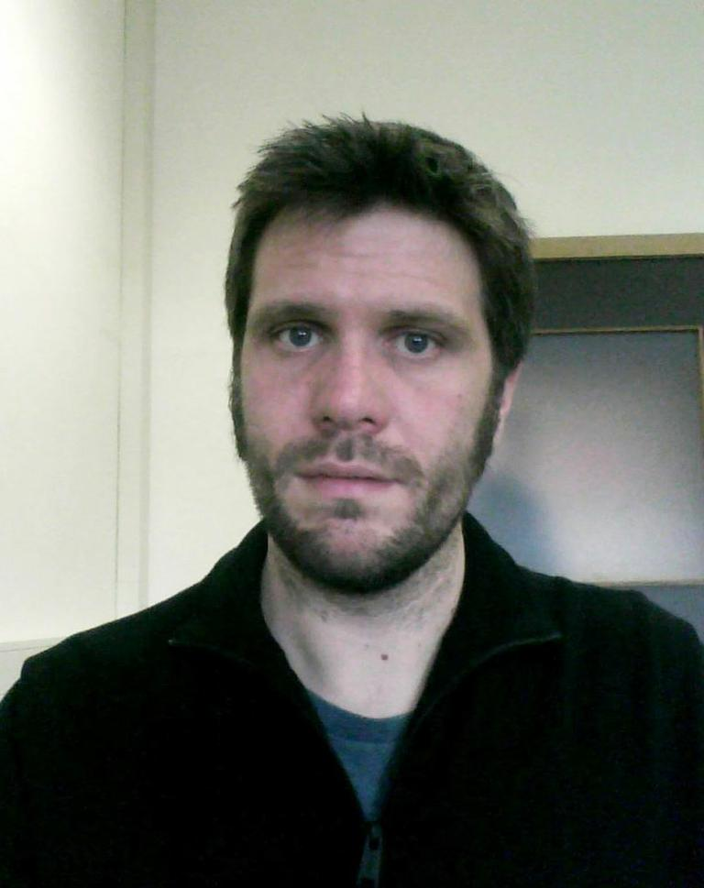
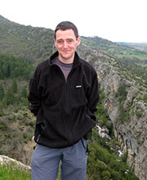
Ta...Pt 1!

Slide 3








Ta...Pt 2!

Slide 4
Agenda
Constitution
Committee positions
Other membership recognition
Postgraduate courses
Other society news
Finances
Outreach
AOB

Slide 5
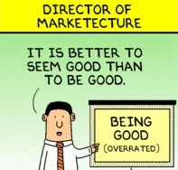
Committee
Executive Committee
Chair: Christopher Jackson (2014-2016), Imperial
Secretary: Ol Wakefield (2016-2018), BGS
Treasurer: Rhodri Jerrett (2015-2017), Manchester
Committee Members
Awards Officer: Esther Sumner (2016-2018), Southampton
Industry Liasons: (1) Sanem Acikalin (2015-2017), Badley Ashton; (3) Simon Lomas (2015-2017), BG; (iv) James Churchill (2015-2017), BG
Postgraduate Reps: (1) Hannah Brooks, Leeds; (2) Luz Gomis, Manchester; (3) Munira Raji, Durham
Website & JISC List Manager: Marco Patacci, Leeds
Outreach Officer: ?

Slide 6
Candidates
Chair
Joris Eggenhuisen
Postgraduate Representative
Kevin Boulesteix
Industry Representative
Nigel Platt (Oyster Petroleum)
Outreach
Yvonne Spychala
Matthew Booth
Sanem Acikalin
Hazel Beaumont

Slide 7


Fund Winners

Slide 8
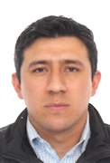
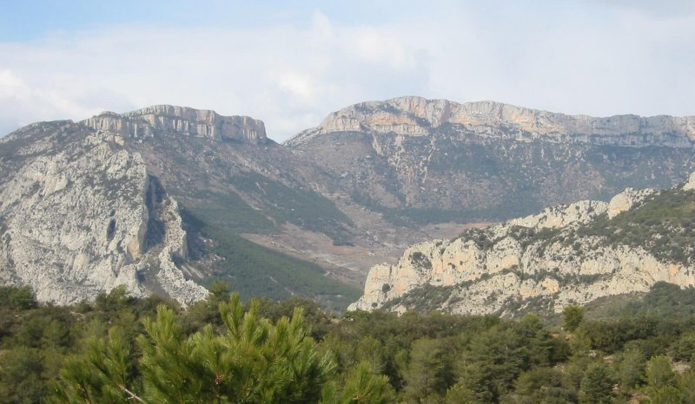
Stephen Farrell Fund
Oscar Baez (University of Leeds) – "Stratigraphic heterogeneity induced by allogenic factors in a Paleogene low net-to-gross fluvial succession, Tremp-Graus, Spain" – Award of £300 towards fieldwork in the Tremp-Graus Basin, Spain (poster presentation)

Slide 9
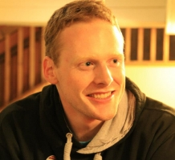
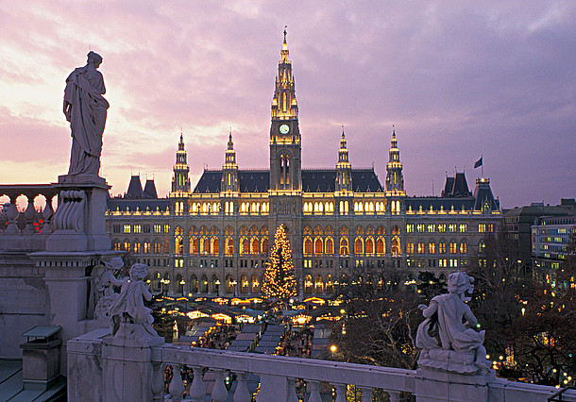
Gill Harwood Fund
Andrew Cunliffe (University of Exeter) – "Carbon dynamics in degrading semi-arid rangeland ecosystems" – Award of £300 to support attendance at the EGU General Assembly in Vienna (read his report online)

Slide 10
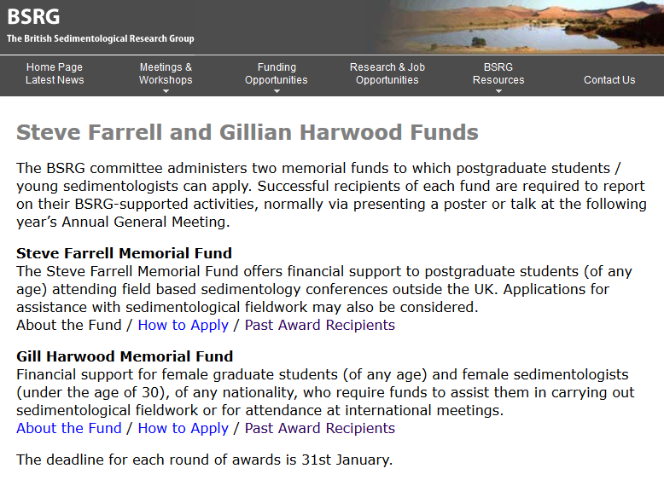
Funding Call 2017
Deadline: 31st January 2017
Successful applications are available to view on the BSRG website

Slide 11
ECR Fund
New fund for Early Career Researchers (ECRs)
Financial support of up to £1000 to support sedimentological research (e.g. field or laboratory) or to attend international meetings.
To support postdoctoral researchers and those within 3 years (full-time equivalent) of starting a permanent academic position
2 page CV, 2 page proposal, budget breakdown and letter of support. Deadline 31st January
Needs a catchier name!!

Slide 12
IAS grants
Travel grants
IAS sponsors sedimentology-related meetings by awarding travel grants to participating IAS student members.
Postgraduate Grant Scheme (PGS)
To help PhD students with their studies by offering financial support for fieldwork, data acquisition and analysis, visits to other institutes to use specialized facilities, or participation in field excursions directly related to the PhD research subject. Up to 10 grants, each of about 1,000 € are awarded, twice per year.
Post-Doctoral Research Grants
Seed money to assist early-career post-doctoral researchers in either establishing a proof of concept, in order to support applications to national research funding bodies, or to fund areas of a project that were not included in the original project scope. Up to 4 grants, up to 2,500 € each, awarded twice per year.

Slide 13
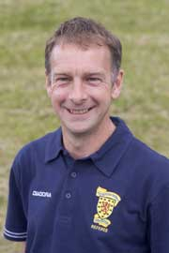
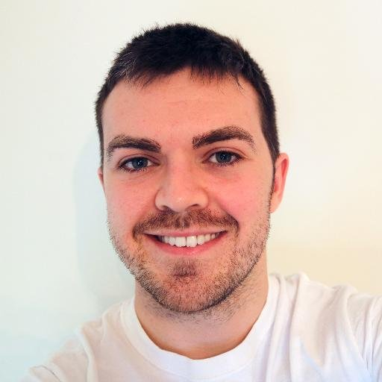
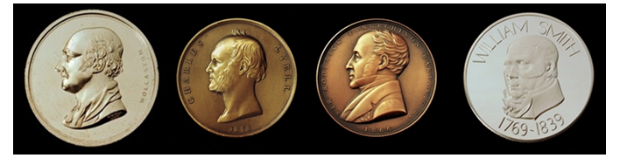
GSL Awards
Prof John Underhill (Heriot Watt) Lyell Medal
Dr Mitch D’Arcy (Imperial College, now Potsdam) Wollaston Fund

Slide 14
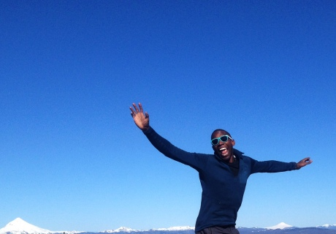

GSA Awards
Prof Chris Jackson (Imperial College)
GSA Thompson International Distinguished Lecturer

Slide 16
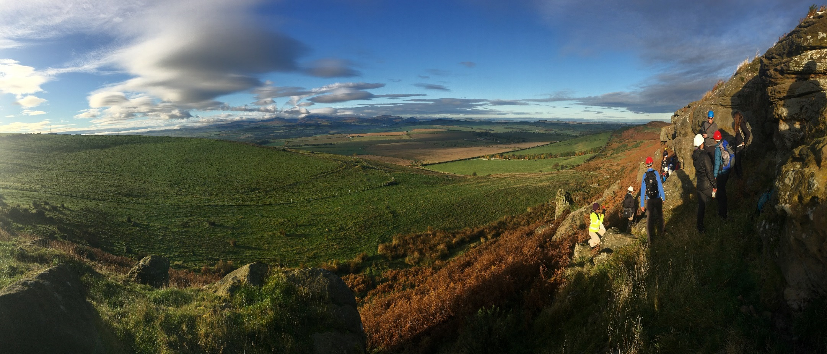
Bowden Doors
Lower Carboniferous fluvial channels
Fell sandstones
Day 1-

Slide 17
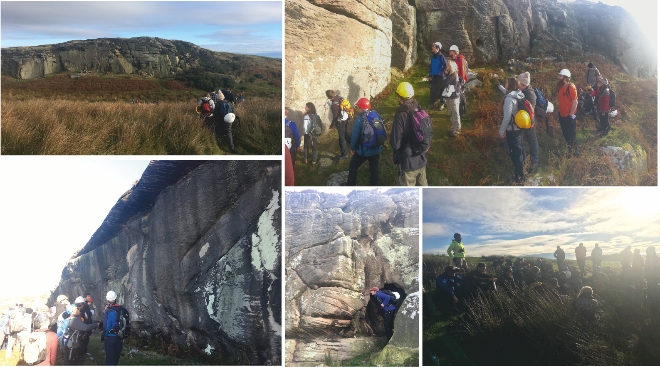
Bowden Doors
Lower Carboniferous fluvial channels
Fell sandstones
Day 1-

Slide 18
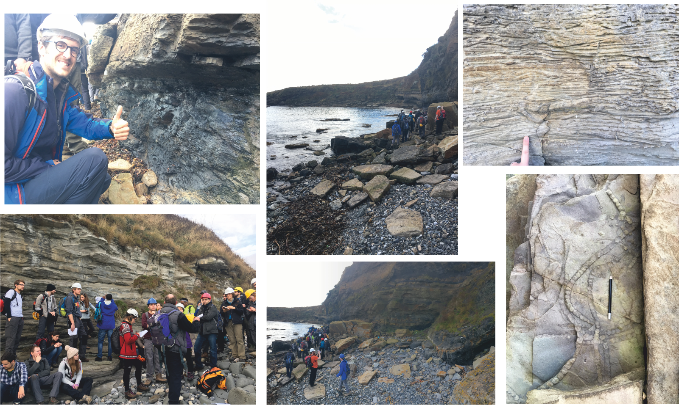
Day 1-
Howick Bay
Cyclothems on the Northumberland coast

Slide 19
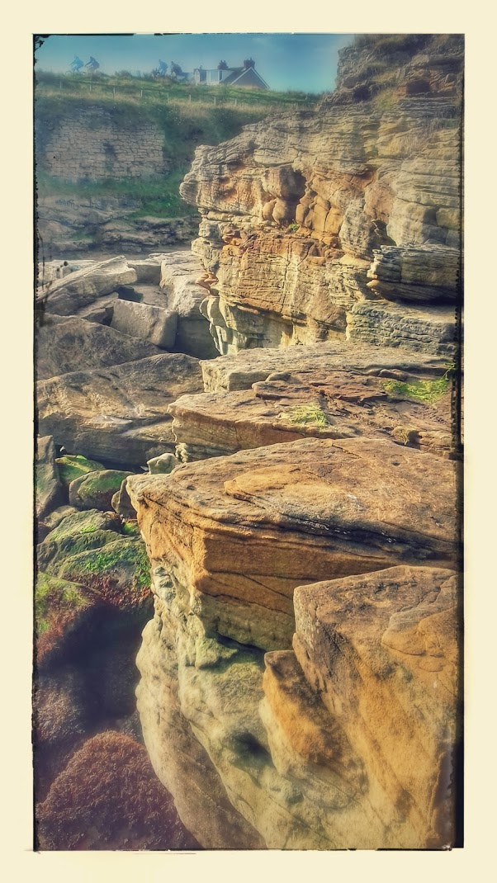
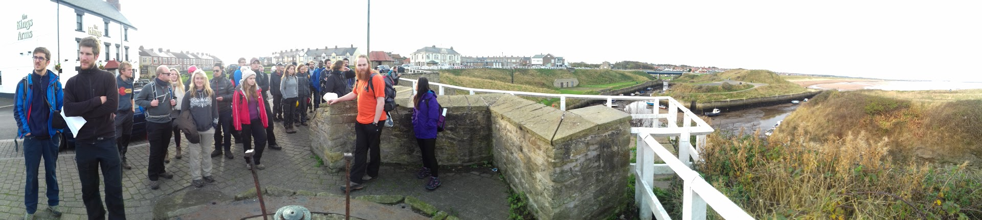
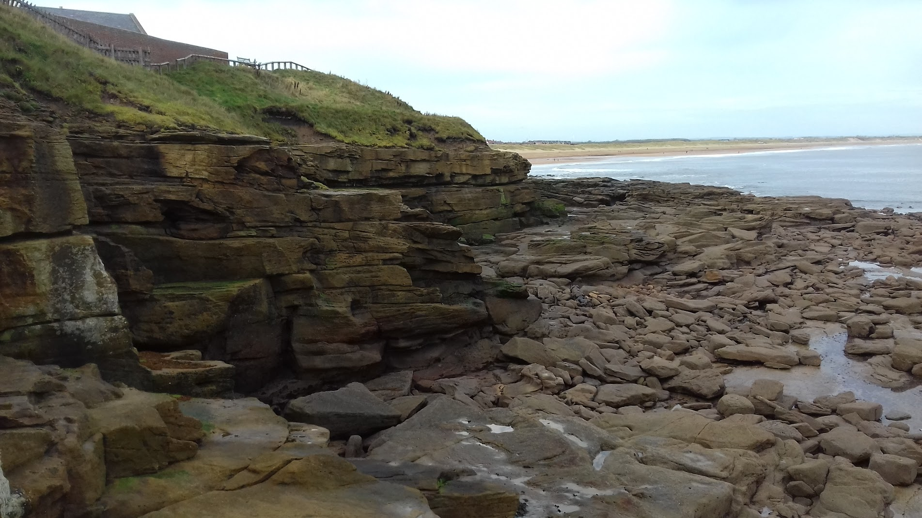
Day 2-
Seaton Sluice
Westphalian channel sandstones

Slide 20
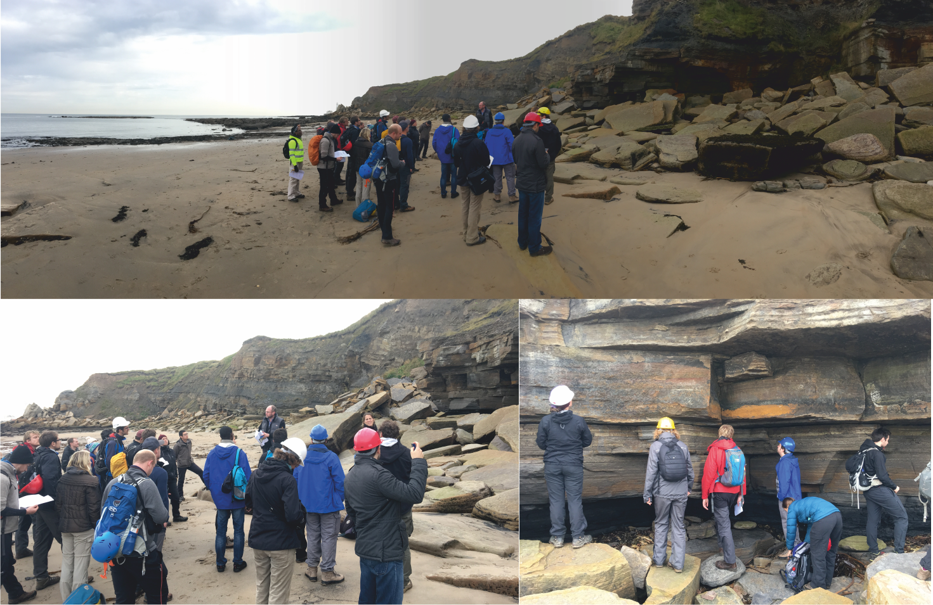
Day 2-
Hartley Bay
Coarsening upwards cycles of Westphalian coal-bearing strata

Slide 21
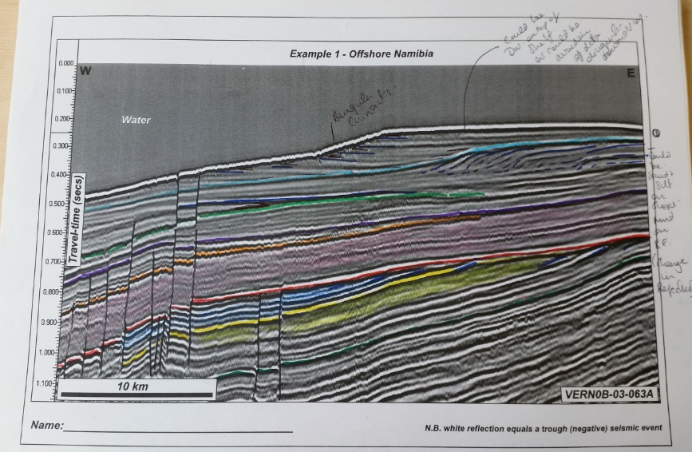

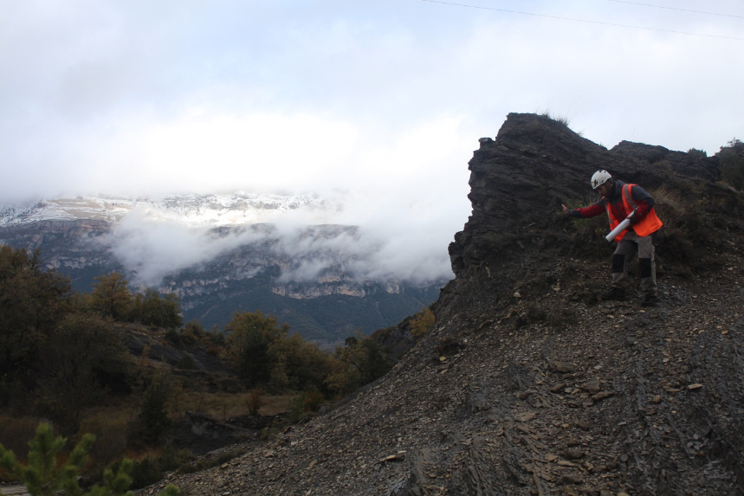

Courses for 2017...?

Slide 22
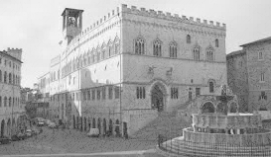

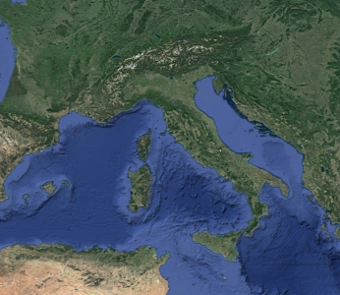
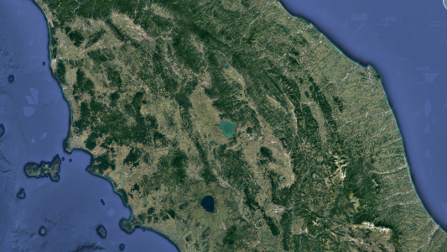



PLIOCENE – PLEISTOCENE CONTINENTAL DEPOSITS
OF NORTHERN APENNINES
16 – 18th June 2017, Perugia, Italy
Florence
Valdarno Basin
Rapolano Terme
Perugia
ITALIAN GEOLOGICAL SOCIETY
XIII MEETING GeoSed
Sedimentary Geology Section
Department of Physics and Geology
University of Perugia
PERUGIA - 16 - 20 June 2017

Slide 23
PLIOCENE – PLEISTOCENE CONTINENTAL DEPOSITS
OF NORTHERN APENNINES
16 – 18th June 2017, Perugia, Italy
E. Capezzuoli (Univ. Perugia) and M. Ghinassi (Univ. Padova)
3 days (16 – 18th June 2017)
Central Italy, Umbria and Tuscany (Perugia, Siena, Florence)
10 GeoSed student members + 10 BSRG student members
Day1. Classes: Geology of Tuscany, overview of alluvial and spring-related depositional systems, introduction to fieldtrips
Day2. Fieldtrip: alluvial deposits of the Upper Valdarno Basin (Florence - Tuscany)
Day3. Fieldtrip: travertine deposits of Rapolano Terme (Siena – Tuscany)
Estimated cost: 90-110 € / 75-90 £ (includes didactic materials, coffe breaks, 3-days packed lunches, minibus for fieldtrips). Possibility of agreed prices for accommodation
Important dates: 30 th January 2017 (first circular)
28 ^{th} February 2017 deadline for subscription

Slide 24
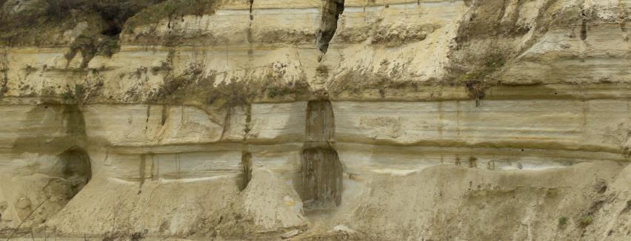
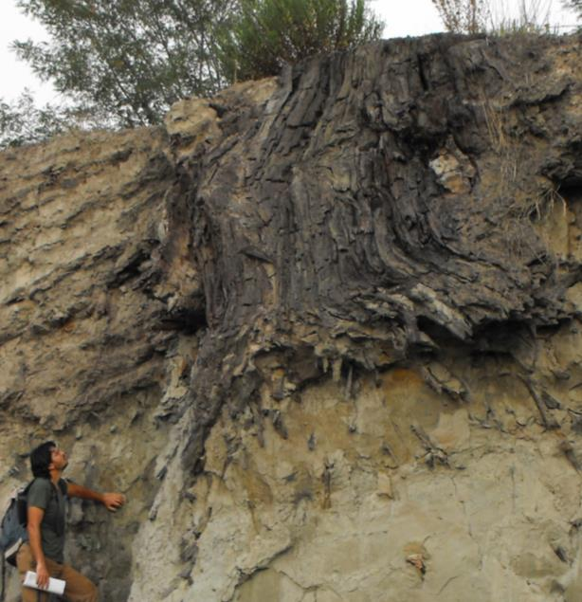

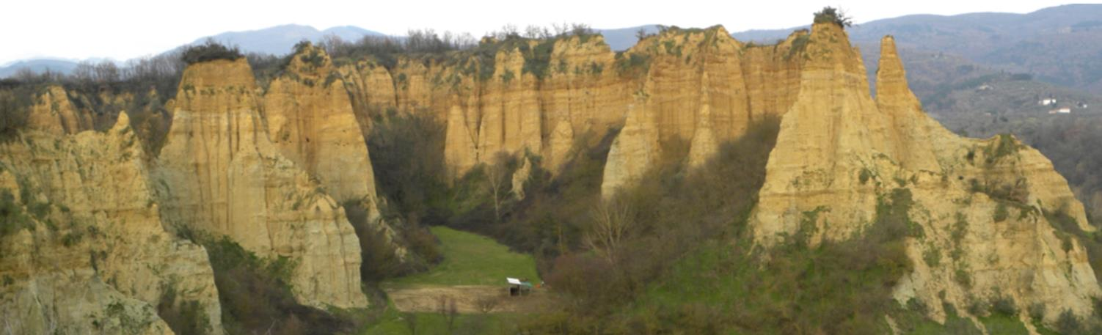
PLIOCENE – PLEISTOCENE CONTINENTAL DEPOSITS
OF NORTHERN APENNINES
16 – 18th June 2017, Perugia, Italy
Florence
Valdarno Basin
Perugia

Slide 25
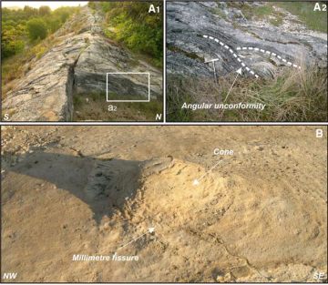
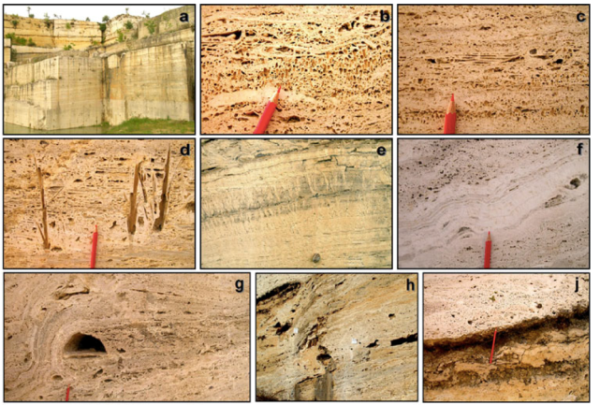
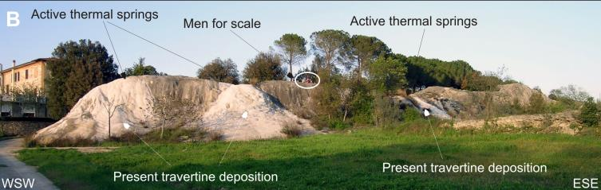
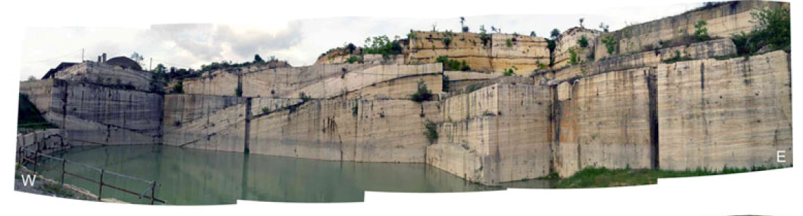
PLIOCENE – PLEISTOCENE CONTINENTAL DEPOSITS
OF NORTHERN APENNINES
16 – 18th June 2017, Perugia, Italy
Siena
SEE YOU IN PERUGIA!!!
Rapolano terme
Perugia

Slide 26
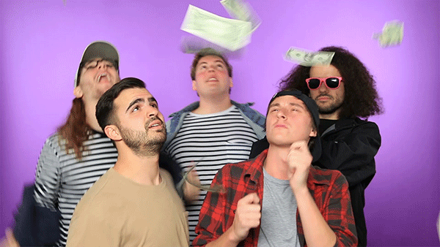
#MakeItRain

Slide 27
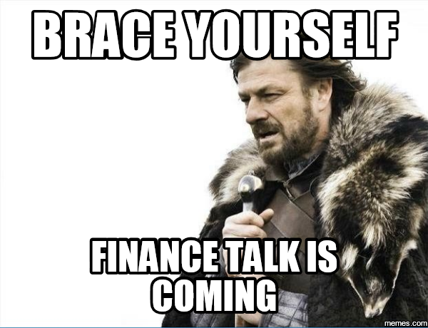
Finance
Current opening balance 01/01/2016: £9743.50
Current “closing” balance 16/12/2016: £6745.38
Savings account: £18.5K (making little interest)
Activities this year:
Prizes (Farrell/Harwood): -£1,440
PG Fieldtrip (Northumbria): -£657.28
Webinar (Reesink): -£250.00
Running Website (Patacci): -£40.85
AGM: +428.32 to +928.32 (estimate)
Set-up of Trevor Elliott Fund: +£2,700
In summary, we spent £887.47 more than we made this year.
Including the Trevor Elliott Fund, we are up by £1,812.53
N.B. Account has not recouped all the sponsorship and income from AGM (hence difference)

Slide 28


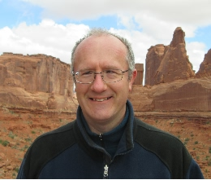
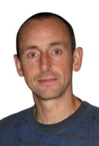
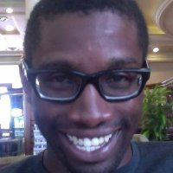
Related Societies
Gary Hampson
Nigel Mountney
Chris Jackson

Slide 29
Reasons to join SEPM (Society for Sedimentary Geology)
Your entrée into the lively global community of sedimentary geoscience
Networking with established scientists for advice and mentoring
Ability to apply for SEPM Foundation Student Grants
Special rate for online access to SEPM journals (Journal of Sedimentary Research)
Special student pricing on all SEPM publications (~50% list)
Heavily discounted registration fees for SEPM activities including meetings, research conferences, short courses and field trips
Student membership costs $15 per year
Optional $15 journal subscription
Optional $15 access to online books archive
SEPM ambassador for UK: Gary Hampson (g.j.hampson@imperial.ac.uk)

Slide 30

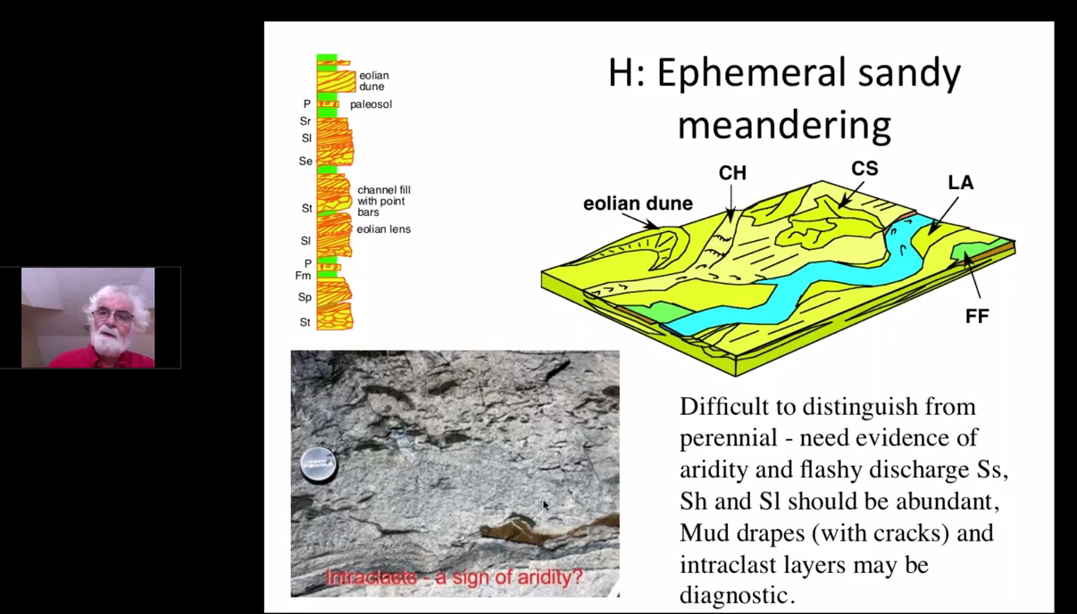
BSRG-supported activities
September 16th 2016
https://www.youtube.com/watch?v=FQ-O8YEXtjQ

Slide 31


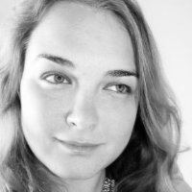
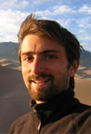
Outreach
JISC (email) list: >1000 subscribers
Facebook: >620 followers
Twitter: >500 followers (twittermistress: Yvonne Spychala)
Website: PhD opportunities, meeting information, fund/award winners, BRSG history, etc (webmaster: Marco Patacci)

Slide 32
AOB
BSRG AGM 2017 (Utrecht, Newcastle, Heriot-Watt)
Closing remarks...
Notes:
Posters vs. talks (no micro-managing, but increased balance between talks/posters)
Student-led sessions...

Slide 33
A key component of this first meeting was the presentation of “research work in progress” by research students
Discussion were “...lively and informal...”
The ethos of BSRG is encapsulated by Perce Allen’s vision in 1962 for future AGMs: they would need to be run by a simple organisation that “depended for life on its own enthusiasm”. The organisation should be independent from other geological bodies “to avoid ossification and to be free to die if enthusiasm waned”. “Emphasis should be on the younger worker and on informality”. From its inception, BSRG has been organised with a light touch
We also still aim to foster the development of young sedimentologists, and the BSRG AGM is the venue at which many PhD students present their research results for the first time

Slide 34


The BSRG Constitution

Slide 35
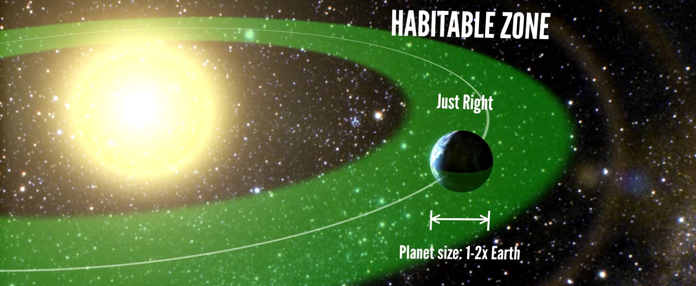
Aims
Provide an updated governing document…
…providing context but not being too descriptive

Slide 36
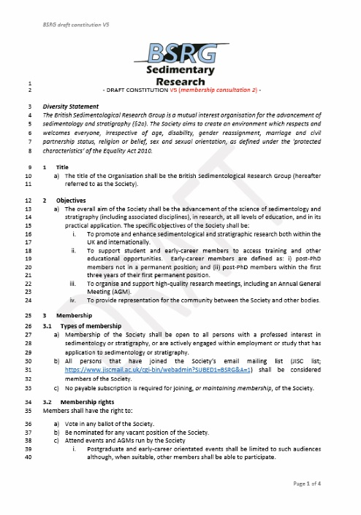
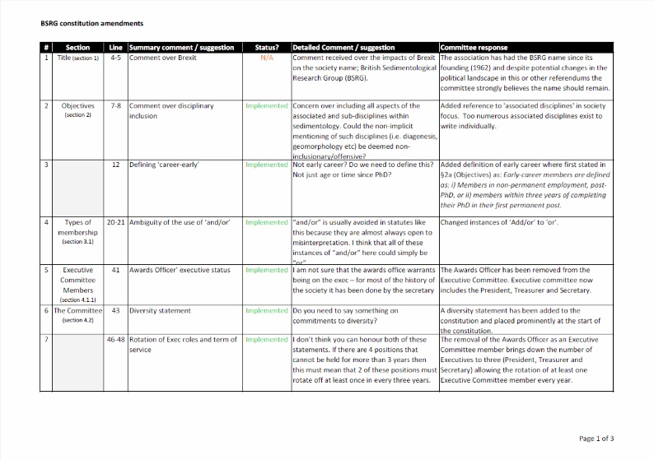
The Process
V4 sent out for membership consultation
V5 created from consultation
Discussion (hopefully limited)
  Scope for implementing additional changes
Vote to accept / reject constitution (show of hands?)

Slide 37
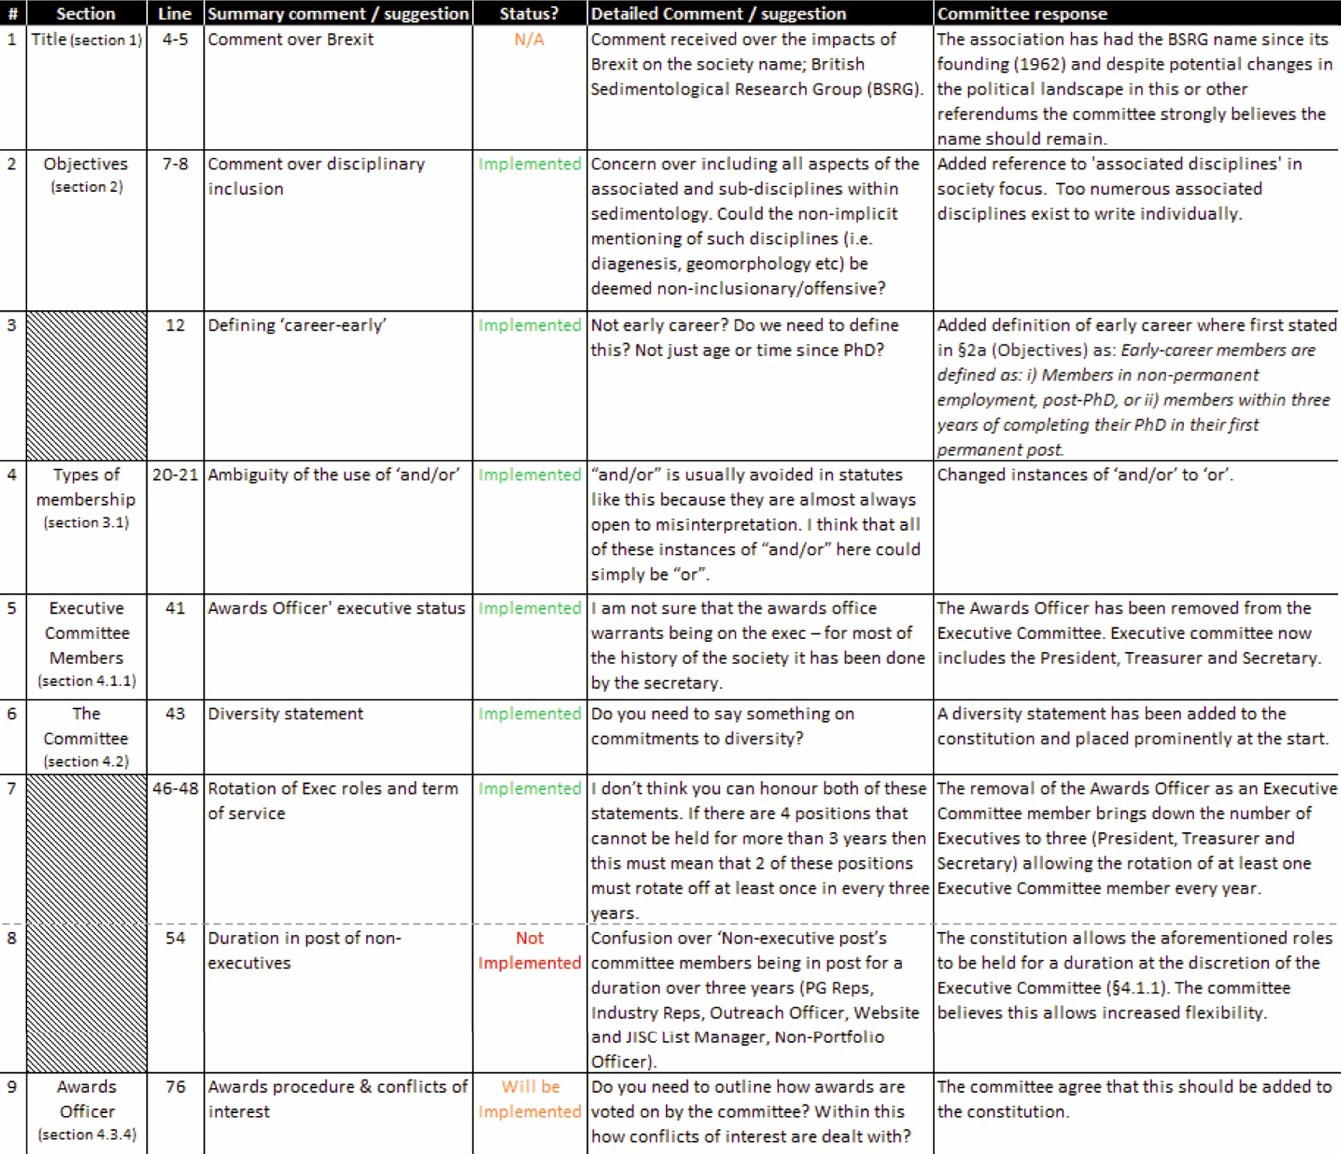

Slide 38
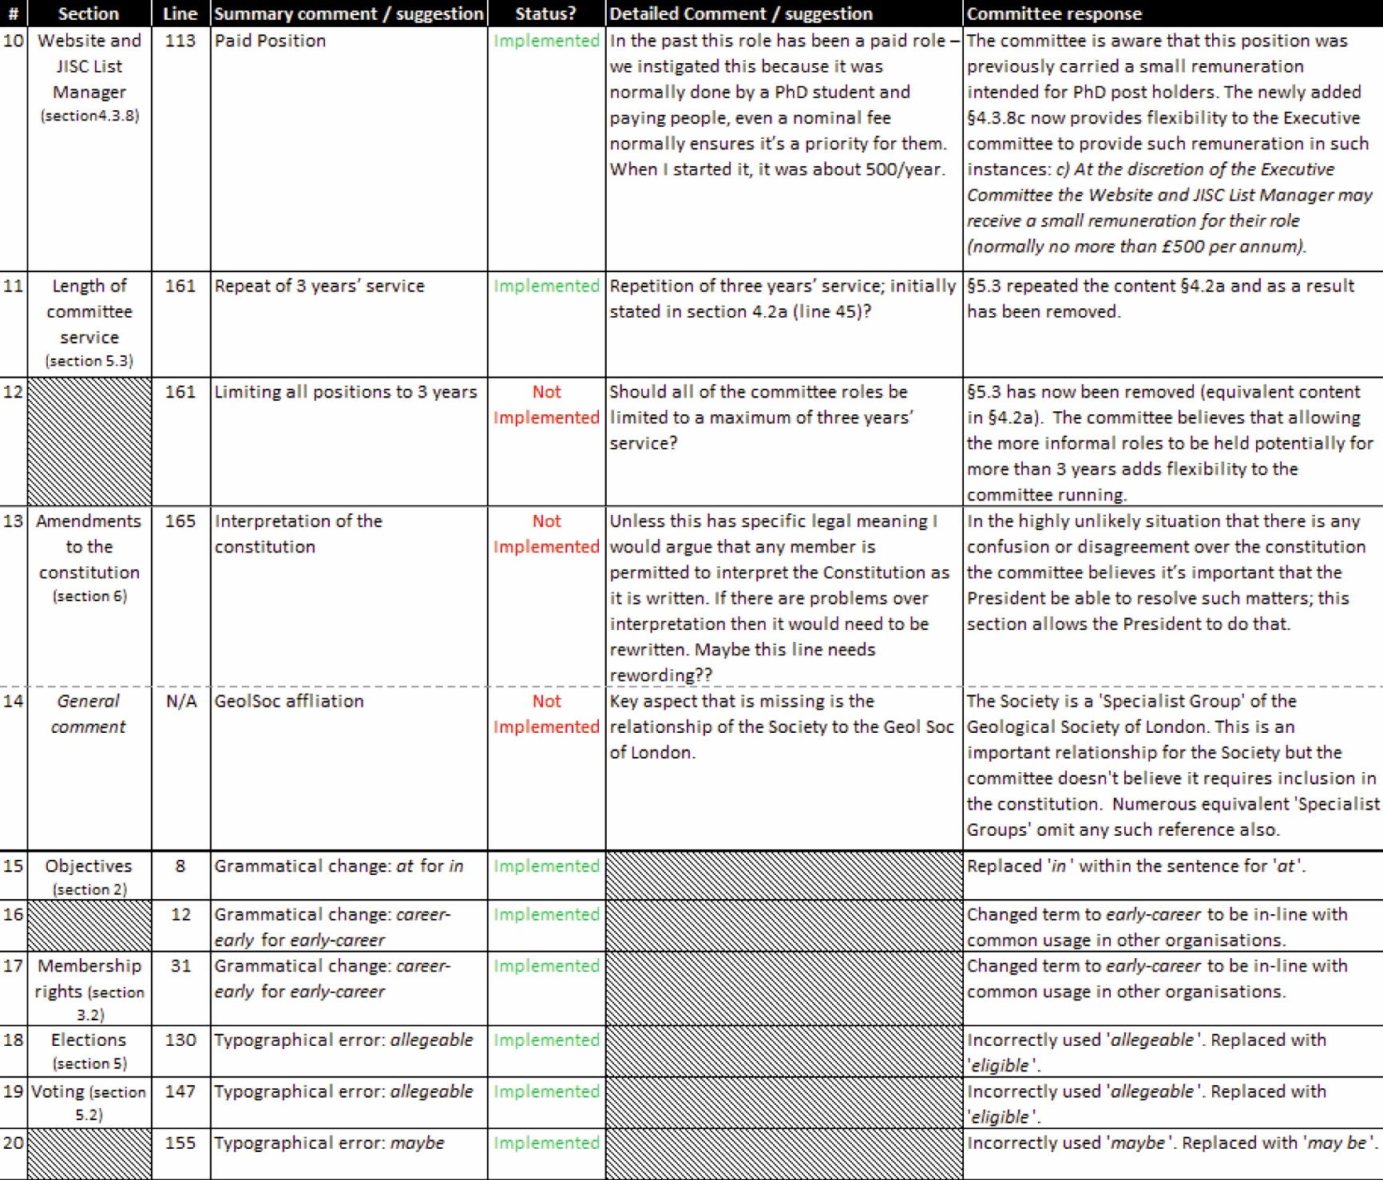

Slide 39



